Slide 1

Beer Engine
By Anthony Russo

Slide 2
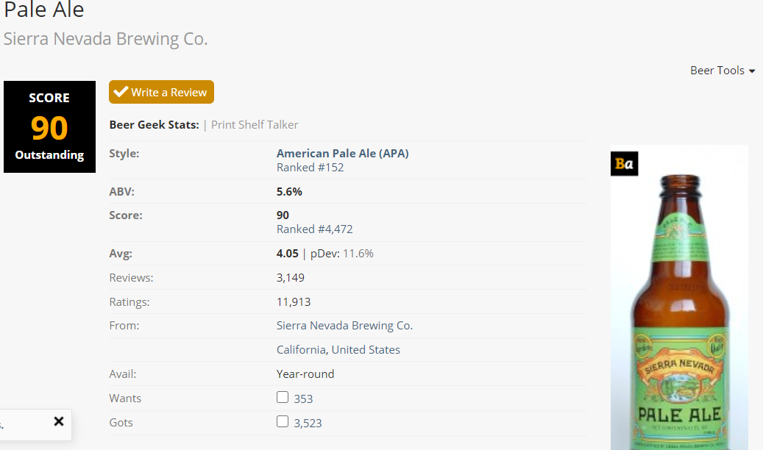
Introduction
The Beer Engine uses machine learning.
Take a photo -> Get beer review!

Slide 3

How it Works?
TensorFlow intro
Training the algorithm
Fine tuning to get more accuracy

Slide 4
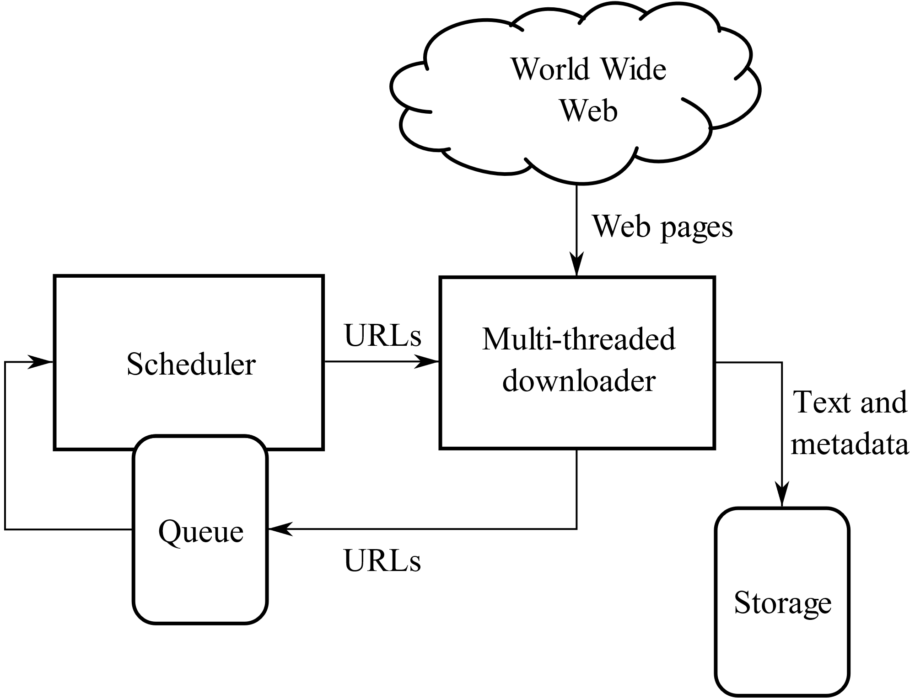
Gathering Data
Machine learning requires test data
We utilized web crawling to gather images and beer names

Slide 5

Using the Cloud
All machine learning data will be stored on the cloud
This offers scalability, access, and speed

Slide 6
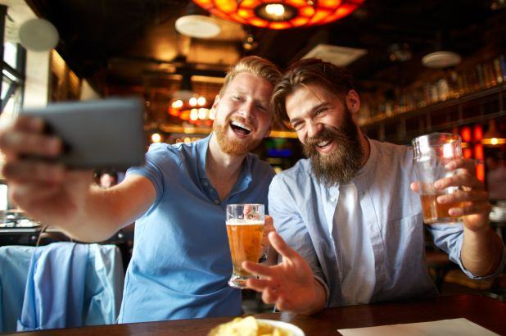
User Input
User browses to web application
Takes picture
Uploads
BOOM!

Slide 7
Beer Engine Output
Beer up-to-date review
Style
ABV
Location
Brewery details
Rankings

Slide 8
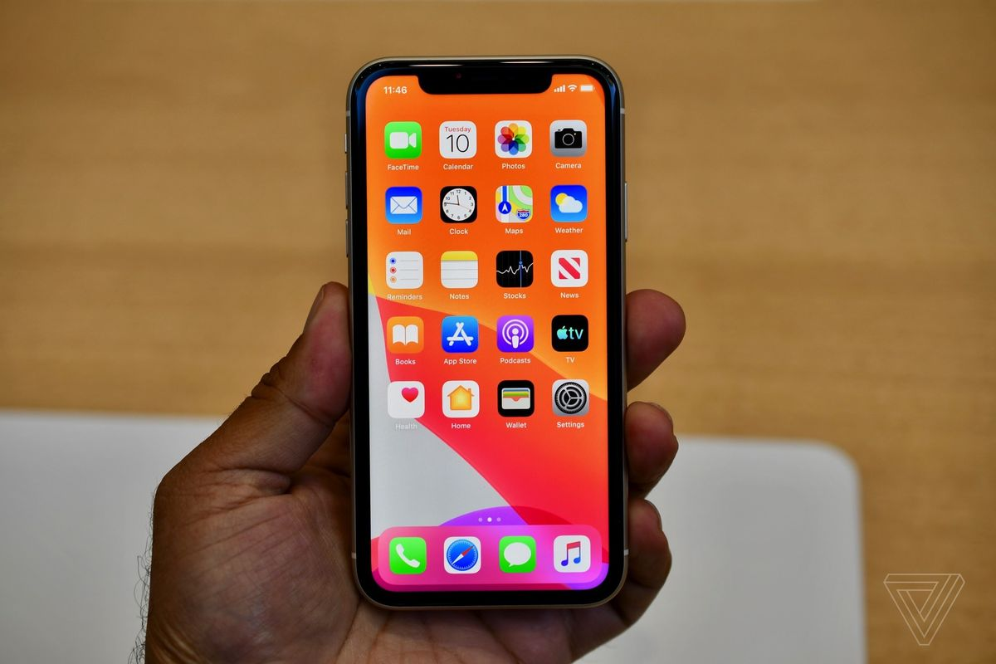
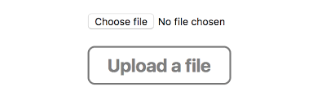
Beer Engine Mock Up

